Slide 2
Paws In Need Mission
Reduce overpopulation
and suffering
Prevent euthanasia
due to financial hardship
For community animals
in the Tri-Valley area

Slide 3
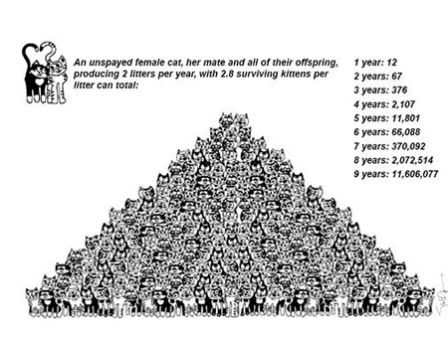
Too Many Cats- where will they go?
Notes:
Year 3= Each of these 42 pairs will have three litters of 4 each. 42X12=504 | 72 kittens from grandparents | 12 kittens from great grandparents | Total=588 new kittens at the end of the 3rd year

Slide 4
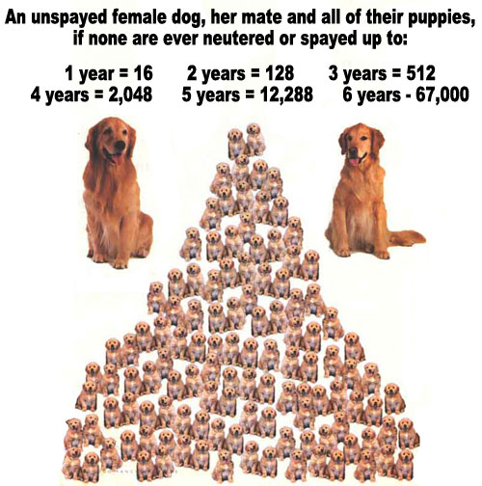
Too Many Dogs – What will happen to them all?
Notes:
Year 3= Each of these 42 pairs will have three litters of 4 each. 42X12=504 | 72 kittens from grandparents | 12 kittens from great grandparents | Total=588 new kittens at the end of the 3rd year

Slide 5
2014 Goal
Spay/Neuter 250+ animals
Will prevent ~1,500+ from being born this year

Slide 6
Strategies to accomplish our Mission
Program #1:
Spay/Neuter reduces over-population in our community
Program #2:
Just Like New provides financial assistance for one-time urgent medical treatment of community animals to prevent animal suffering and euthanasia
(previously with
Valley Humane Society)
Ongoing:
Fundraisers and community support through donations and grants

Slide 7
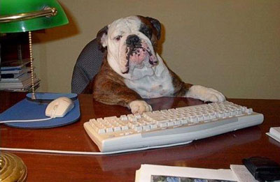
How the mission will be met in 2014
Volunteers are critical
to the success of these programs
and our efforts
We have NO paid staff

Slide 8
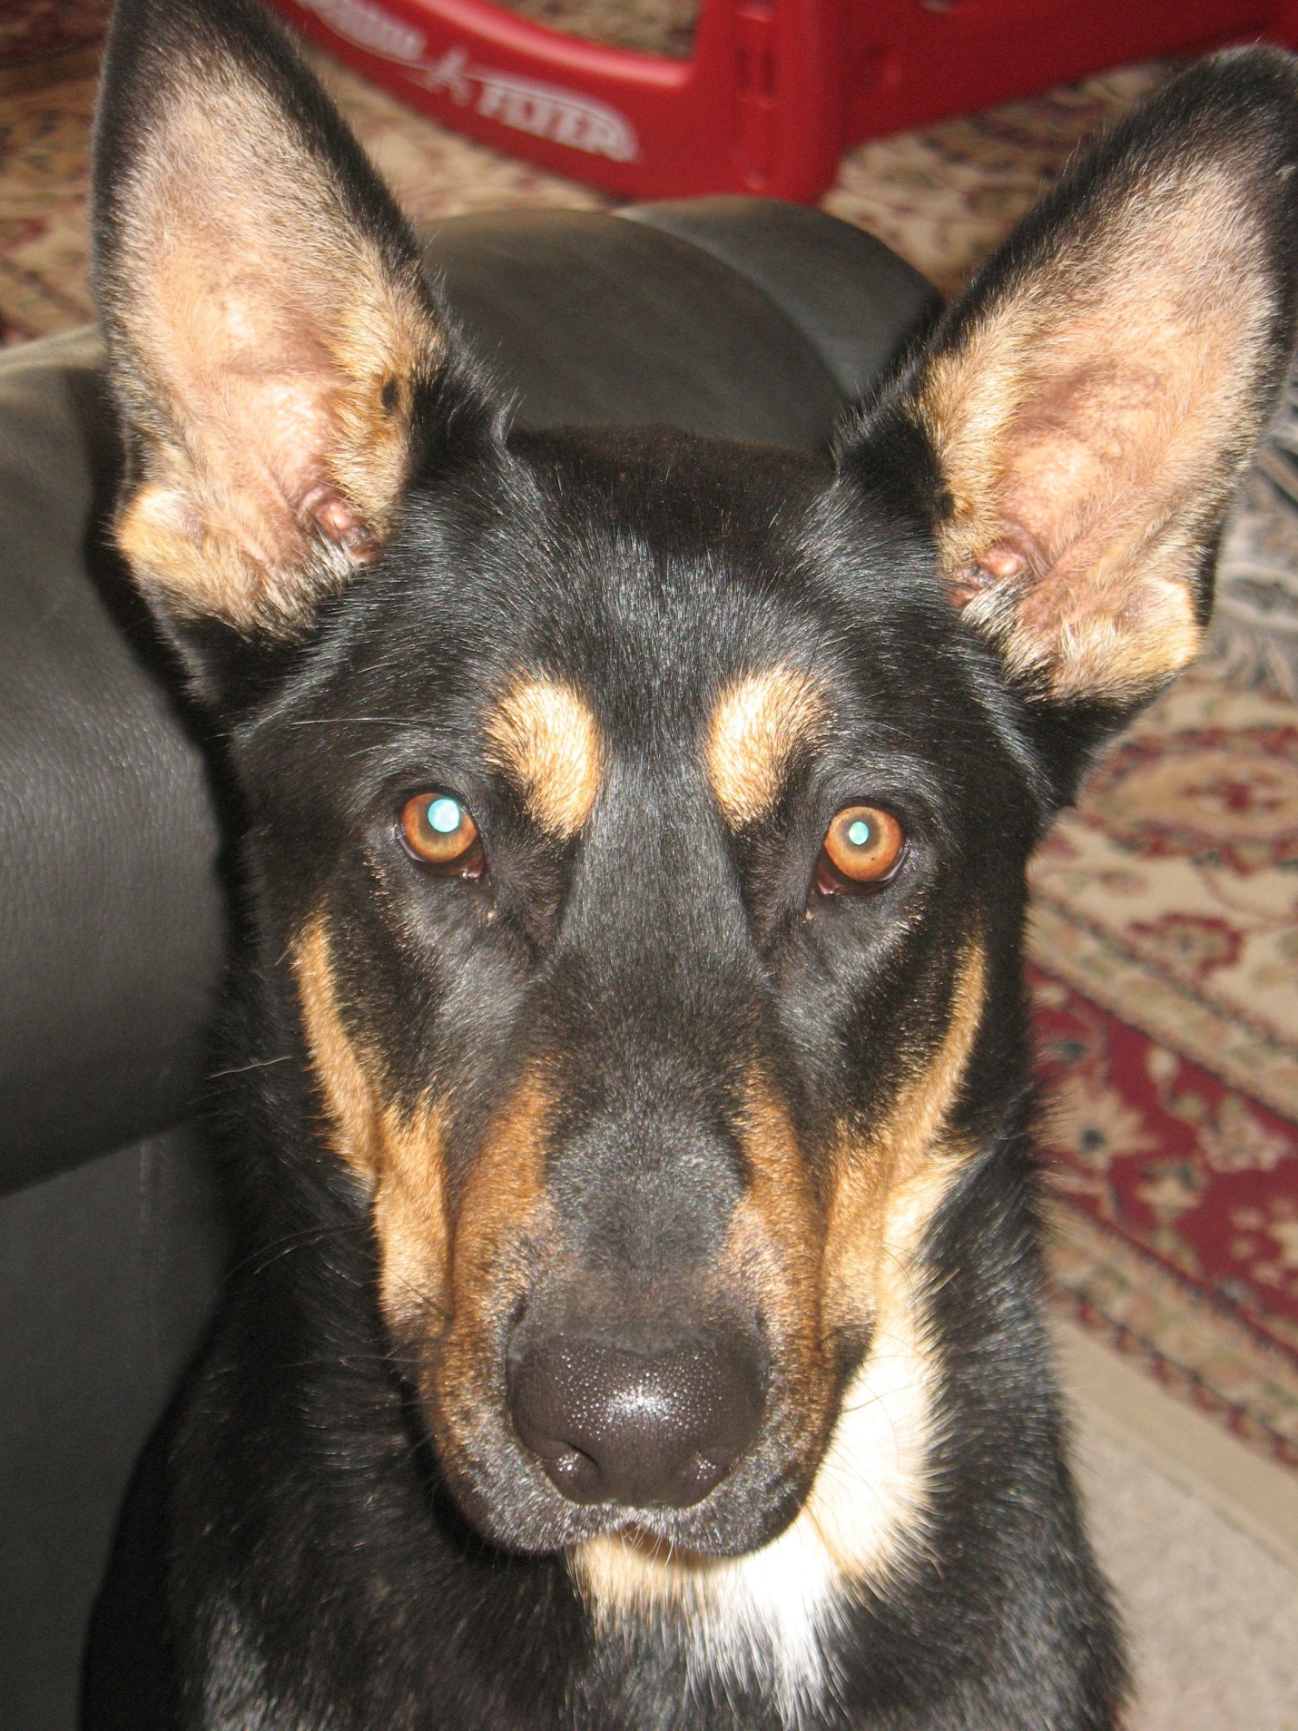
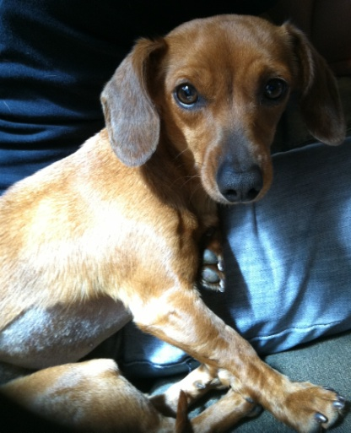
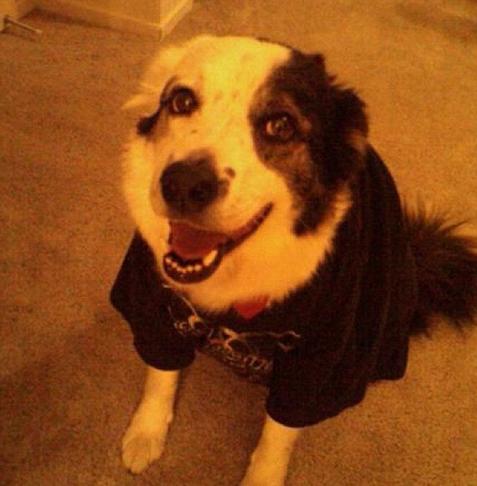
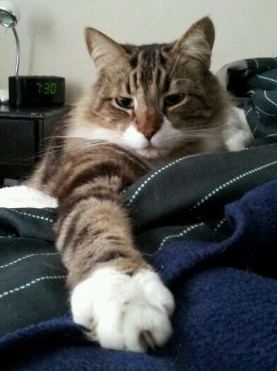
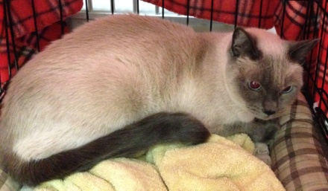
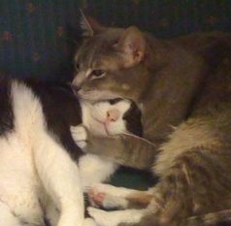
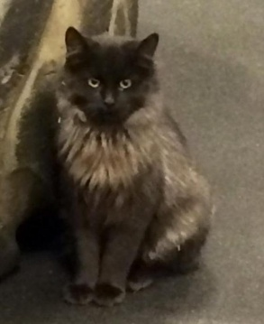
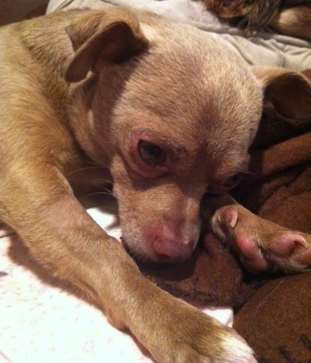
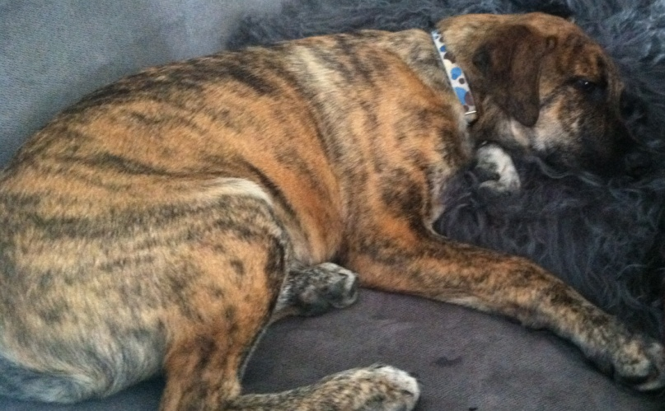
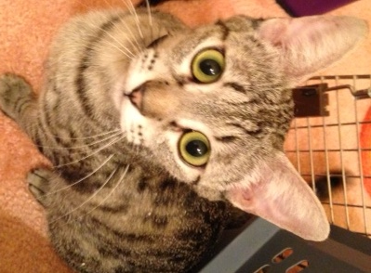
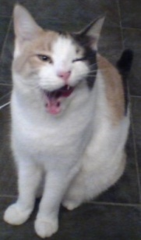
Saving Lives!

Slide 9
Jackie Barnett’s Just Like New Fund
Over 45 animals will be helped
For those who don’t qualify for the program, we provide alternative solutions
Examples of those recently helped

Slide 10
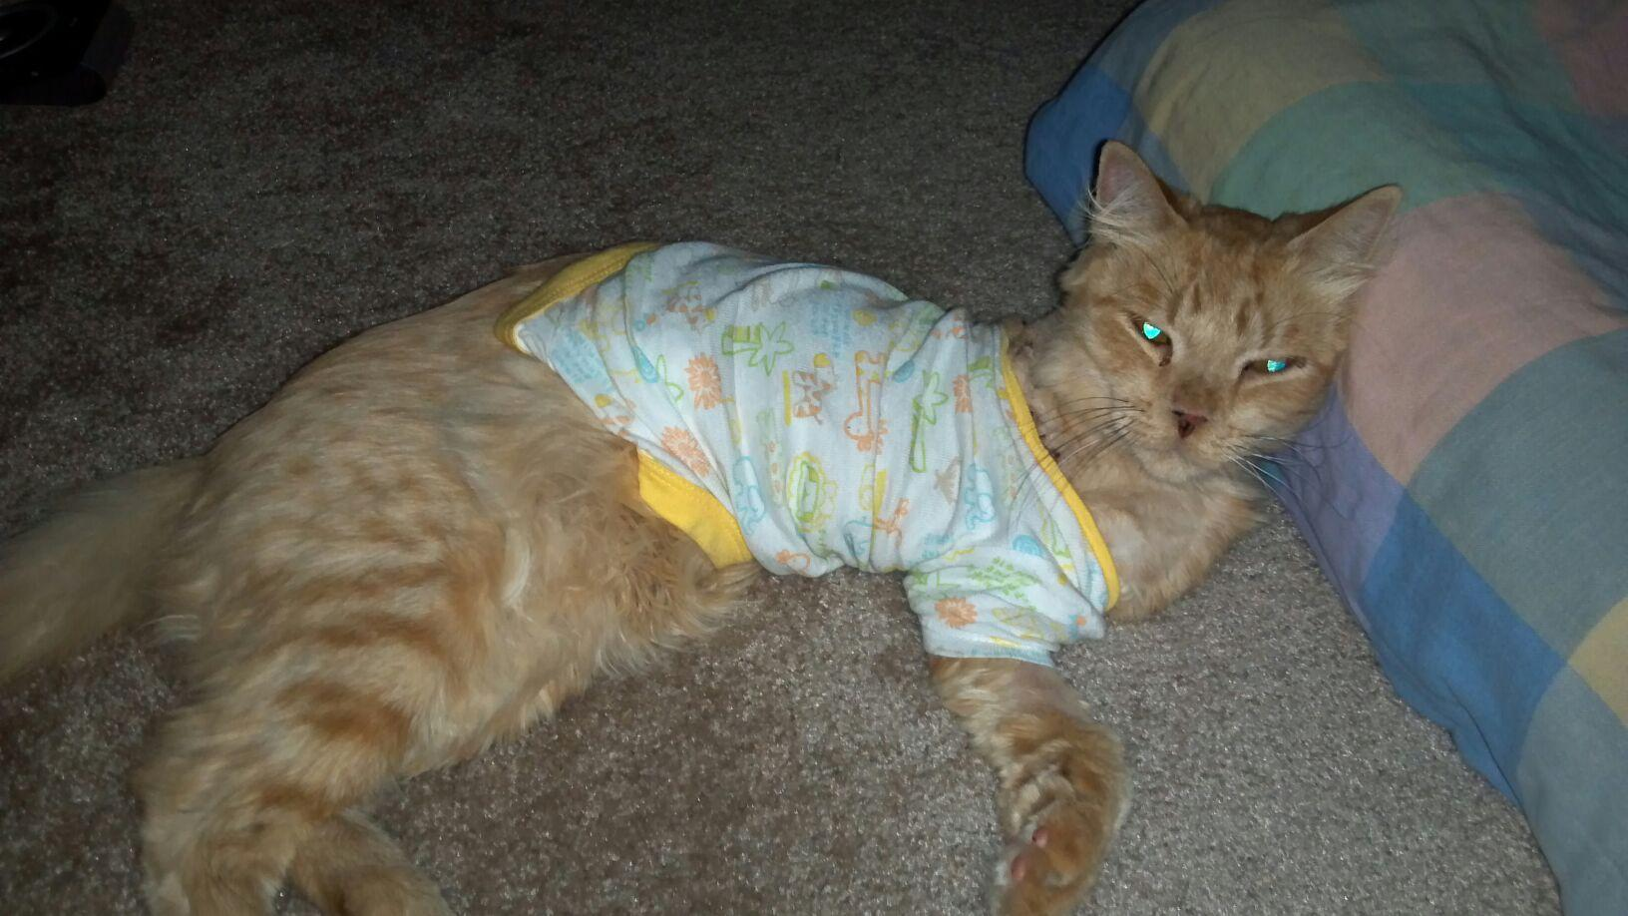
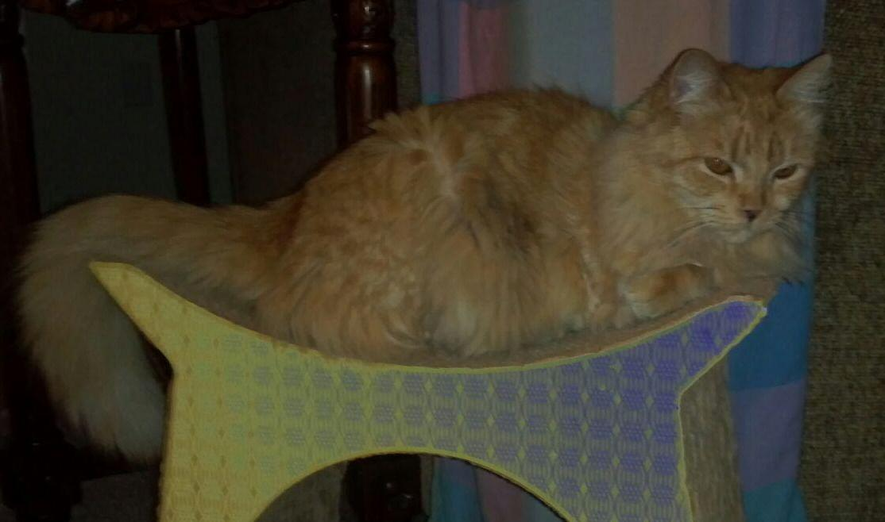
Simba

Slide 11
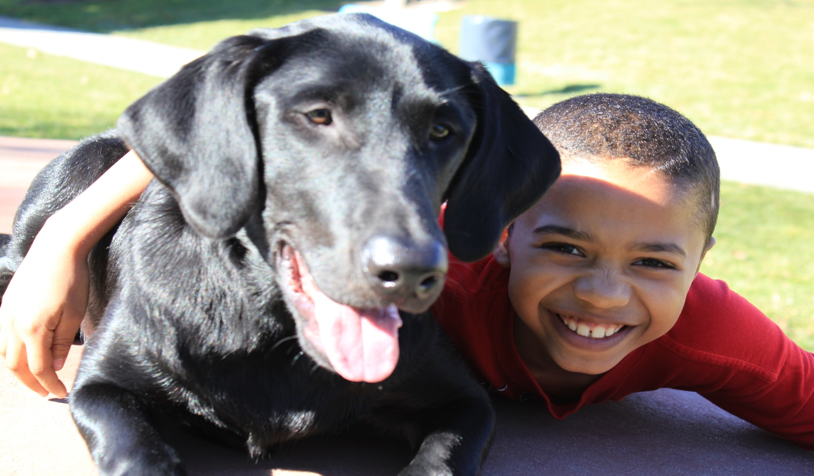
Syrah

Slide 12
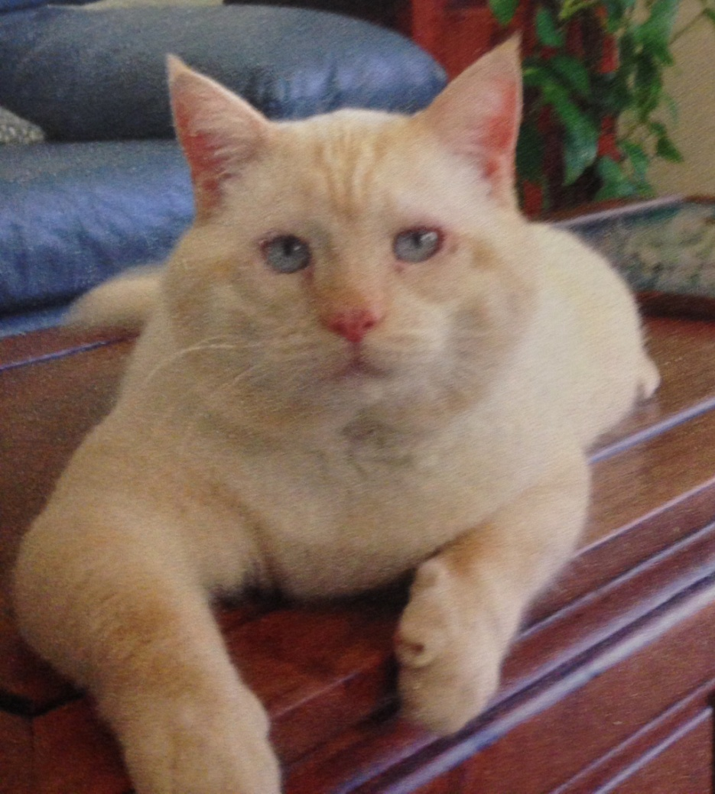
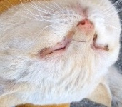
Buffy
BEFORE AFTER
His eyelashes were scratching his eyes
and it was too painful to open them

Slide 13
Attend Our 2014 Fundraising Events
Annual Crab Feed – 2nd Saturday in February
Yard Sale – Sat. May 3rd at Milfleur, Pleasanton
BBQ – Sat. Sept. 20th at Olivina, Livermore
Halloween Photo Shoot - Sat. Oct. 18th at Milfleur, Pleasanton
Holiday Boutique – Sat. Nov. 8th, at Feline Medical Center in Pleasanton
Animal Lover’s Boutique – Year Around Unique items for people and their pets. In the lobby of Feline Medical Center in Pleasanton

Slide 14
Additional Ways You Can Help
Workplace Campaigns
United Way, LLNL HOME campaign, etc.
Grants from your workplace
Chevron, Visa, etc.
Pet food companies
ESCRIP (Rewards program) escrip.com
Register your credit/debit cards for Paws in Need

Slide 15
Thank you for coming tonight!
YOU help make the difference
in the lives of animals
in our community

